Slide 1
REAL TIME SIGN LANGUAGE RECOGNITION USING DEEP LEARNING
GUIDE BY
Ms.D.REJEES JENIFA
PRESENTED BY
210820205063 PRIYADHASINI .P
210820205047 LAVANYA .Y
210820205055 PIRAKTHIKSHA T

Slide 2
ABSTRACT
The "Real-Time Sign Language Recognition " project is an innovative endeavor that leverages Convolutional Neural Networks and TensorFlow to develop an assistive technology system capable of interpreting sign language gestures in real time. This system aims to bridge the communication gap between sign language users and non-users by translating sign language into text or speech, thus facilitating seamless interaction in various contexts. The project involves collecting and preprocessing a diverse dataset of sign language gestures, designing and training a CNN model for accurate gesture recognition, and implementing the model in a real-time application with a user-friendly interface. Rigorous testing and validation are conducted to ensure the system's reliability and accuracy in different environments. The ultimate goal is to deploy the system on accessible platforms, making it widely available to enhance inclusivity and accessibility for individuals with hearing impairments

Slide 3
INTRODUCTION
The project "Real-Time Sign Language Recognition using Deep Learning" is designed to create an advanced assistive technology system that leverages the power of Convolutional Neural Networks (CNN) and TensorFlow to interpret sign language gestures in real time. By capturing live video feeds of sign language gestures through a camera, the system employs deep learning algorithms to analyze and classify each gesture into its corresponding textual or spoken interpretation. This innovative approach aims to bridge the communication gap between sign language users and those unfamiliar with sign language, facilitating seamless interaction in various settings such as education, healthcare, and social interactions. The project encompasses the development of a user-friendly interface, rigorous testing in diverse environments, and deployment on accessible platforms to ensure wide-reaching impact and inclusivity. Through real-time sign language recognition, this project seeks to empower individuals with hearing impairments, fostering greater accessibility and understanding in our increasingly digital world.

Slide 4
OBJECTIVE OF THE PROJECT
The primary objective of the "Real-Time Sign Language Recognition using CNN" project is to develop an efficient and accurate system that can recognize and interpret sign language gestures in real time using Convolutional Neural Networks (CNNs).
The system aims to provide a seamless communication bridge between individuals who use sign language and those who do not, enhancing inclusivity and accessibility.
By leveraging deep learning techniques, the project seeks to accurately classify hand gestures captured through a camera feed and translate them into spoken language, thereby facilitating effective communication for the deaf and hard of hearing community.

Slide 5
SCOPE OF THE PROJECT
High Accuracy and Robustness:
Achieve high accuracy in recognizing hand gestures across different environments, lighting conditions, and subjects. The system should be robust to variations in gesture appearance and background noise.
Real-Time Performance:
Ensure the system can process video streams in real-time with minimal latency, providing immediate feedback on recognized gestures. This requires optimizing model inference and image processing pipelines.
User Experience:
Create an intuitive and responsive user interface that leverages hand gesture recognition to enable natural and efficient user interactions. The interface should be accessible and easy to use, enhancing the overall user experience.

Slide 6
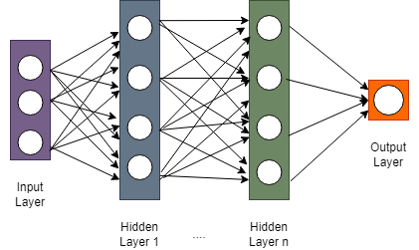
DOMAIN OF THE PROJECT
Deep learning is a subset of machine learning that revolves around artificial neural networks, which are computational models inspired by the human brain's structure. These networks, with their deep architectures featuring multiple layers of interconnected neurons, excel at learning hierarchical representations of data. Deep learning algorithms learn from data through training, adjusting their parameters iteratively to minimize prediction errors. One of the key advantages is representation learning, where models automatically learn meaningful features directly from raw data, eliminating the need for manual feature engineering. This approach has revolutionized various fields by enabling machines to learn complex tasks directly from data, achieving state-of-the-art performance in areas like image recognition, natural language processing, and more.

Slide 7
Literature Review
S.No | Tittle | Year | Methodology | Influence (Disadvantages)
1 | A new data glove approach for Malaysian sign language detection | (2020) | Develop a data glove with tilt sensors and an accelerometer for sign language detection. Test the accuracy of the data glove in translating selected signs from Malaysian Sign Language. | Data glove may not provide the level of detail required for accurate recognition of complex signs. Average accuracy for translating all gestures is 89%, indicating room for improvement.
2 | Image-based and sensor-based approaches to Arabic sign language recognition | . (2021) | Utilize CNNs and transfer learning models to recognize Arabic Sign Language characters from images. Evaluate the performance of different pretrained models, focusing on InceptionV3. | Specific to Arabic Sign Language and may not be directly applicable to other sign languages. High computational resources required for training and inference.

Slide 8
S.No | Tittle | Year | Methodology | Influence (Disadvantages)
3 | Recognition of sign language alphabets and numbers based on hand kinematics using a data glove | (2021) | Employ a data glove to capture finger and wrist joint angles for sign language recognition. Use an SVM with 10-fold cross-validation for real-time recognition. | Data glove may not be as accessible or cost-effective as camera-based solutions. Limited to recognizing a subset of sign language alphabets and numbers.
4 | Nearest neighbour classification of Indian sign language gestures using kinect camera | (2021) | Implement a recognition system using the Microsoft Kinect camera to collect sign language symbols . Apply nearest neighbor classification for recognition. | Reliance on the Kinect camera may limit portability and compatibility. Recognition rates are not perfect, indicating room for improvement.
5 | Sign language recognition using deep learning on custom processed static gesture images | (2022) | Apply CNNs to recognize static sign language gestures using Inception v3.Preprocess images to serve as cleaned input for the model | Limited to recognizing static gestures, may not handle dynamic signs well. Validation accuracy above 90% suggests a margin for error.

Slide 9
EXISTING SYSTEM
In the existing face recognition systems, Mittal et al. proposed a system that used an LSTM model with leap motion for continuous sign language recognition.
They employed a four-gated LSTM cell with a 2D CNN architecture for sign sentence recognition and assigned a particular label to every word.
When the three basic gates were used as an input gate, a forget gate that took the output at the t-1time generated output at the output gate and returned the label showing the word that was specifically associated with that label
They added a special symbol, $, which indicated the transition between the two consecutive signs in the video. The RESET flag was used when they encountered the transition between two signs, which was indicated by the $ sign.
They trained this modified LSTM model over a dataset and achieved a maximum accuracy of 72.3% using a 3-layer LSTM model for sign sentence recognition. For sign word recognition, the achieved accuracy was 89.50%.

Slide 10
Existing system’s Disadvantages
Reduced Accuracy
Increased False Matches
Computational Complexity
Privacy Concerns

Slide 11
PROPOSED SYSTEM
The proposed system integrates a Convolutional Neural Network (CNN) architecture implemented with TensorFlow to significantly enhance accuracy, achieving recognition rates between 90-100%.
By utilizing CNNs, the system effectively extracts intricate features from video frames, including hand gestures, body movements, and facial expressions crucial for accurate interpretation of American Sign Language (ASL).
Through extensive training on a diverse dataset of ASL gestures, the CNN model demonstrates remarkable precision and reliability in real-time prediction.
With its high accuracy rates and user-friendly interface, the system aims to revolutionize communication accessibility for ASL users, empowering them to interact seamlessly in various setting.

Slide 12
PROPOSED SYSTEM’S ADVANTAGES
Reduced Accuracy
Increased False Matches
Computational Complexity
Privacy Concerns

Slide 13
DFD Level 0
Input
(Sign language gesture)
Machine learning Algorithm
Output
(words/
Alphabet)

Slide 14
DFD Level 1
Input
(Sign language gesture)
Using
Open CV
Dataset collection
Output
(words/
Alphabet)
Using CNN algorithm

Slide 15
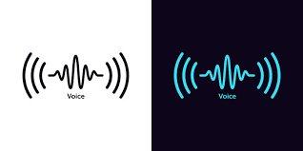
SYSTEM ARCHITECTURE
Train the finger
gestures
Testing phase
Raw data
Performing sign symbol
Data Preprocessing and Feature Extraction
Classification of finger gesture
Tracked data
Camera capture
Trained data
extracted data
Captured data
Train the Data Using CNN Algorithm
Finger posture
tracking
Match with training sets
Matched data
speech
Text data
Sign Recognition
Results in Text formate

Slide 16
SYSTEM MODULE
Module 1: Dataset Collection
Module 2:Data Preprossing and Feature Extraction
Module 3:Training the Dataset
Module 4: Data Conversion
Module 5: Test the Data
Module 6: Text To Speech Translation

Slide 17
MODULE DESCRIPTIONS Module 1: Dataset Collection
Environment Setup:
Arrange a consistent background and good lighting to minimize shadows and highlights. Use a fixed camera setup to maintain a standard frame size and angle.
Recruit Participants:
Gather a diverse group of individuals to perform the gestures. Diversity includes different hand sizes, skin tones, and possibly wearing accessories like rings or gloves to introduce variability.
Hardware and Software Setup:
Use a webcam or a camera-equipped device to record video footage. Choose appropriate lighting conditions to ensure clear video quality. Install video recording software or use built-in webcam software on your computer.

Slide 18

Module 1: Data collection

Slide 19
Module 2 :Data Preprossing and Feature Extraction
This method of hand recognition uses the media pipe library, a tool for image processing, to first identify hands in webcam images. Hence, once the hand has been extracted from the picture, we obtain the region of interest (Roi), which is then cropped and turned into a grayscale image using the OpenCV library after gaussian blur has been added. The open computer vision library, generally known as OpenCV, makes it simple to apply the filter. Using threshold and adaptive threshold approaches, we then transformed the grey picture into a binary image. For signs with the letters A through Z, we have gathered pictures of various signs from various viewpoints. There are many flaws in this method, such as the requirement that your hand must be in front of a clear, soft background and that it be in good lighting conditions for it to produce accurate results. However, in the real world, neither good backgrounds nor good lighting conditions are always present. Thus, after experimenting with several strategies, we came up with an intriguing method in which we first used media pipe to identify hands from frames and then obtained the hand landmarks of the hands that were present in that picture before drawing and connecting those landmarks in a plain white image and later we converted into landmark system.

Slide 20
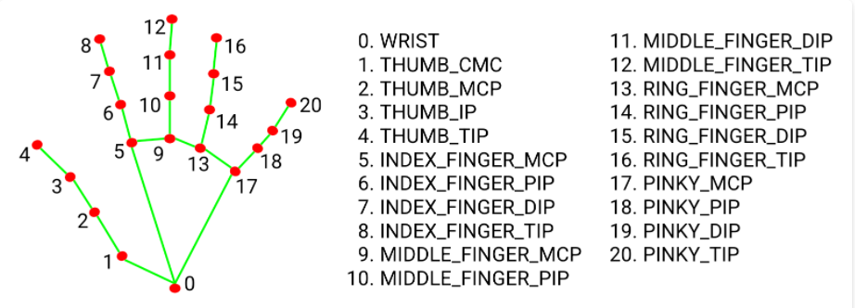
Feature Extraction
Feature Extraction aims to reduce the number of features in a dataset by creating new features from the living bones (and also discarding the original features). These new reduced set of features should also be suitable to epitomize atmost of the information contained in the original set of features. In this way, a summarised interpretation of the original features can be created from a combination of the original set. Another generally used technique to reduce the number of points in a dataset is point Selection. The difference between point Selection and point birth is that point selection aims rather to rank the significance of the being features in the dataset and discard less important bones.
The feature extracted in the feature extraction module is the angles and lines. For extracting the angle features, the slopes between each pair of landmarks are calculated.

Slide 21
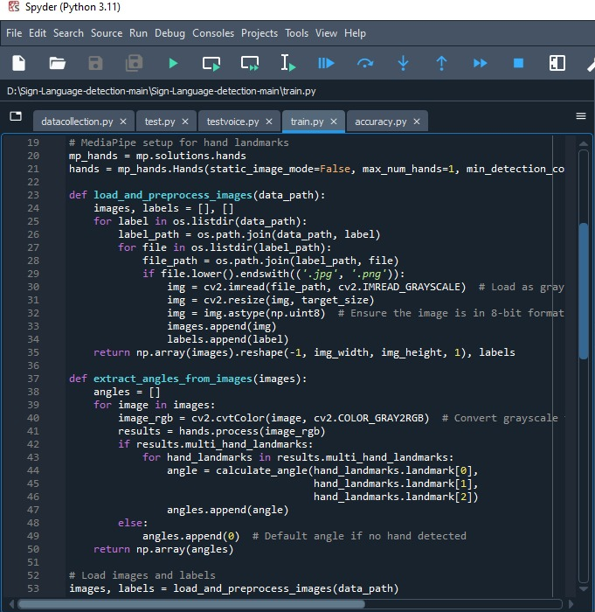
Module 2 :Data Preprossing and Feature Extraction

Slide 22
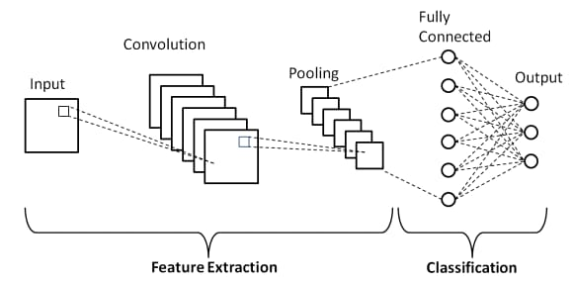
Module 3: Trained The Data
The training complexity is decreased via dimensionality pruning, features minimization, and dimension lowering while keeping the important high variance characteristics. Invariant to scale, direction, and noise, Fourier descriptors are also simple to normalize. The principal component analysis is the technique used to convert correlated data into unadjusted values. The feature vectors are decreased and the original data are effectively translated linearly.
Input Layer:
The input layer receives the input data, which in this case are grayscale images of sign language gestures with dimensions (128, 128, 1) (128x128 pixels with 1 channel for grayscale).

Slide 23
Convolutional Layers (Conv2D):
The first convolutional layer has 32 filters of size (3, 3) and applies the ReLU activation function.The second convolutional layer has 64 filters of the same size (3, 3) and also applies the ReLU activation function.The third convolutional layer has 128 filters of size (3, 3) and applies the ReLU activation function.The fourth convolutional layer has 256 filters of size (3, 3) and applies the ReLU activation function.These layers apply convolution operations to extract features from the input images. Each convolutional layer is followed by a max pooling layer, which helps in reducing the spatial dimensions of the feature maps.
Max Pooling Layers (MaxPooling2D):
Max pooling layers downsample the feature maps obtained from the convolutional layers by taking the maximum value in a specific region (e.g., (2, 2) pooling size).Flatten Layer:The flatten layer converts the multi-dimensional feature maps into a one-dimensional vector, preparing the data for input into the fully connected layers.
Fully Connected Layers (Dense):
The first dense layer has 512 neurons and applies the ReLU activation function.A dropout layer with a dropout rate of 0.5 is added to reduce overfitting.The output layer has the number of neurons equal to the number of classes (in this case, the number of sign language gestures) and applies the softmax activation function to output class probabilities.
Dropout Layers:
These layers randomly ignore (drop out) a subset of neurons during training, preventing overfitting by making the network's neurons less co-dependent on each other.

Slide 24
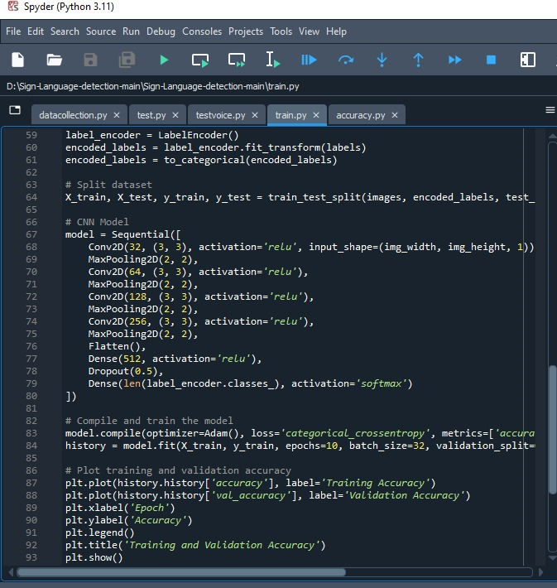
Train and Test The Data Using CNN Layer

Slide 25
Module 4: Data Conversion
The first step in data conversion is image preprocessing, which involves resizing the frames to a uniform dimension, such as 224x224 pixels, to ensure consistency with the CNN's input layer. This resizing is crucial for maintaining the aspect ratio and integrity of the visual information.
Normalization is then applied to the pixel values of the images, scaling them to a range (typically 0 to 1 or -1 to 1) that is optimal for neural network training. This process helps in accelerating the convergence of the model during training and provides numerical stability.In some cases, hand segmentation might be performed to isolate the hand region from the rest of the image.
This step focuses the CNN's attention on the hand gestures, reducing the influence of background noise and irrelevant features. Techniques such as skin color detection, background subtraction, or deep learning-based segmentation can be employed for this purpose.
The preprocessed images are then converted into a numerical format, such as arrays or tensors, that is compatible with the deep learning framework being used (e.g., TensorFlow or PyTorch). This conversion is essential for efficient computation and processing by the CNN.

Slide 26
Module 5: Testing Data
Loading Saved Model:
The trained model can be loaded from the saved file using the load_model function.
Prediction:
Once the model is loaded, it can be used to make predictions on new data (in this case, the test set).
Evaluation:
The model's performance is evaluated on the test data to assess its accuracy and generalization capabilities.By following these steps, we can build, train, and evaluate a CNN model for sign language gesture recognition.

Slide 27
Module 6: Text To Speech Translation
The model translates known gestures into words. we have used pyttsx3 library to convert the recognized words into the appropriate speech. The text-to-speech output is a simple workaround, but it's a useful feature because it simulates a real-life dialogue.
The entry field text value, which represents the phrases or text to be read, will be stored in the message variable. To read the text, lang uses that language. English is used as the default language.

Slide 28
Software requirements
Software : Python
Tools : Anaconda ( spyder python)
Operating System : Windows 7,8,10 (64 bit)

Slide 29
Hardware requirements
Hard Disk :500GB and above
RAM : 4GB and above
Processor :I5 and above

Slide 30
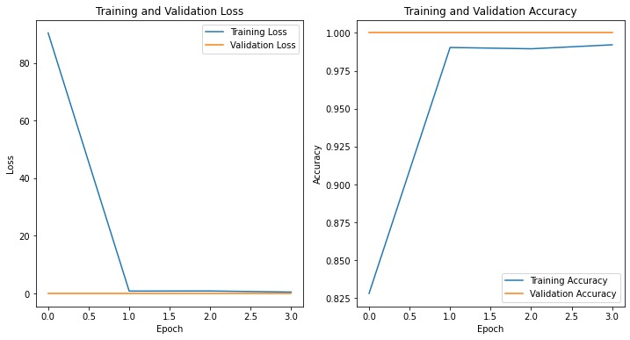
Output: Accuracy and loss

Slide 31
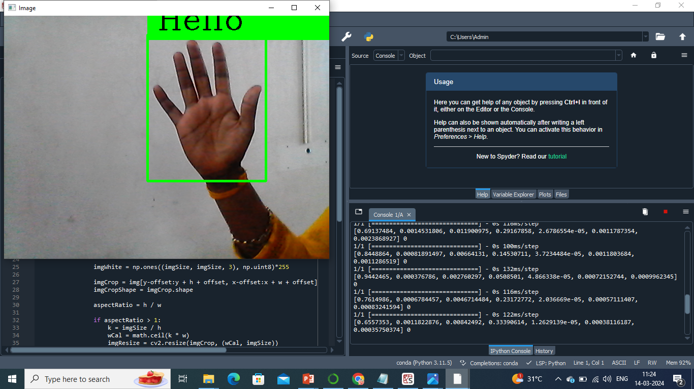
HELLO

Slide 32
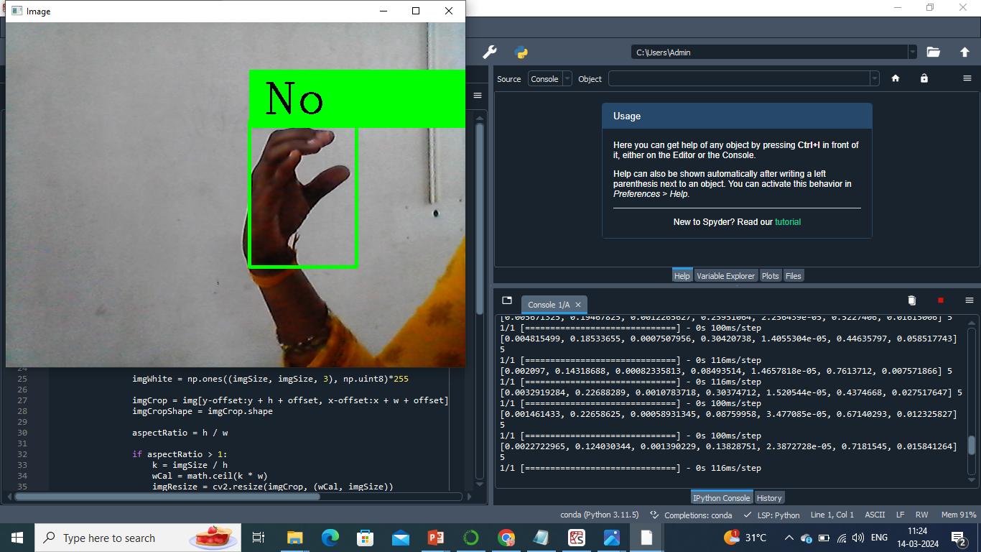
NO

Slide 33
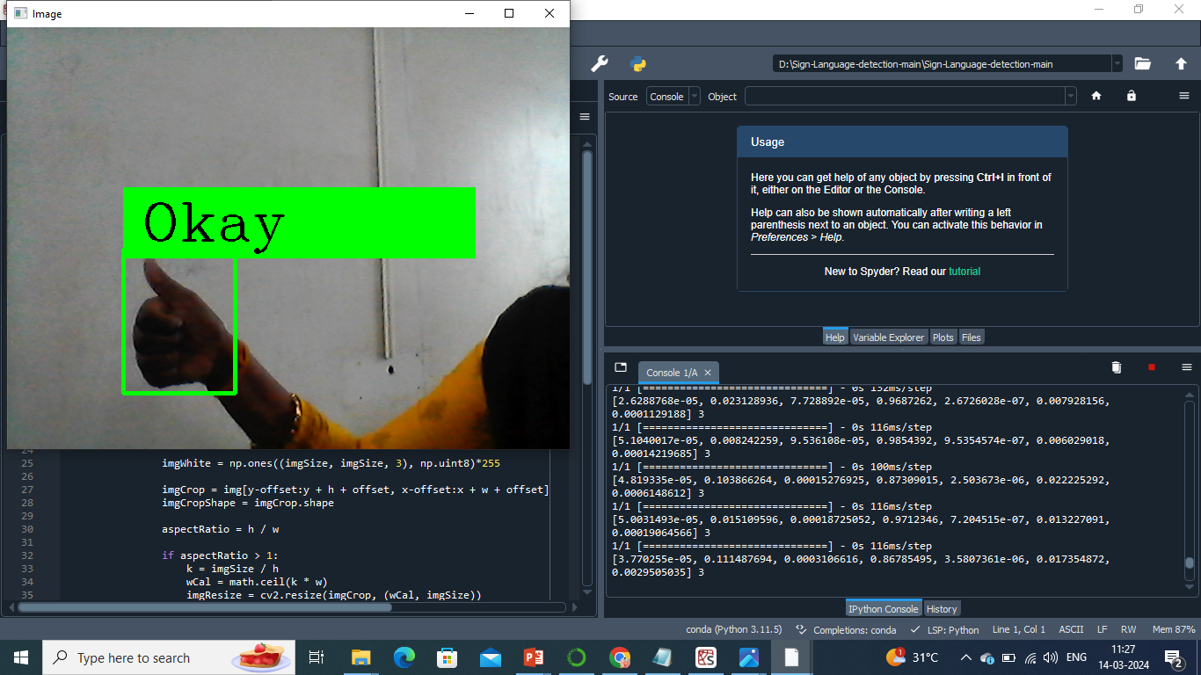
OKAY

Slide 34
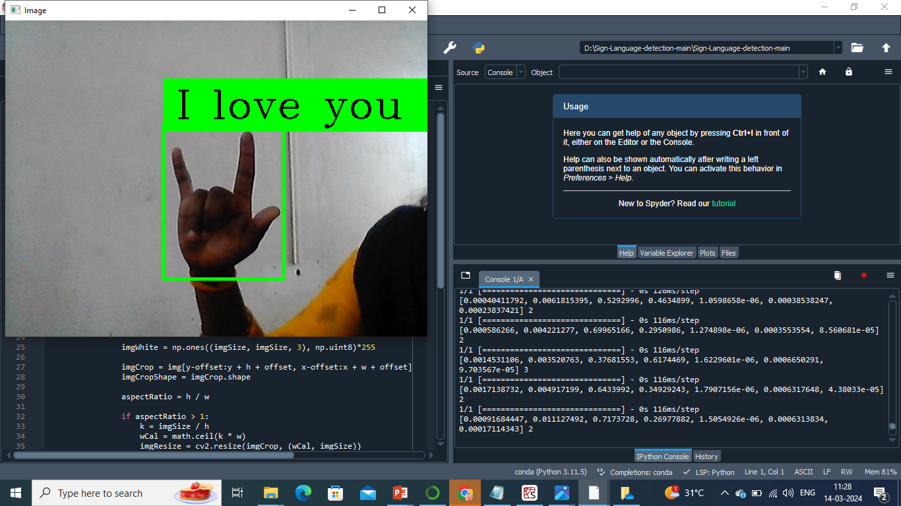
I LOVE YOU

Slide 35
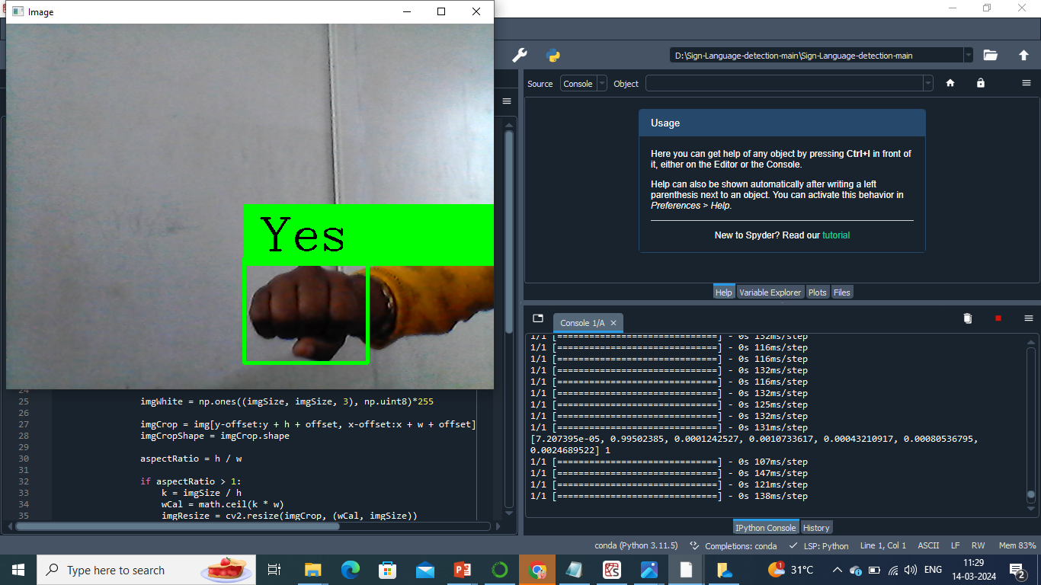
YES

Slide 36
CONCLUSION
In conclusion, the project "Real-Time Sign Language Recognition using CNN" presents a promising solution to bridge the communication gap between sign language users and non-users.
By leveraging the power of Convolutional Neural Networks (CNN) and TensorFlow, the system captures and interprets sign language gestures in real time, translating them into text or speech.
The Data Collection, Data Preprocessing, Training, Data Conversion, and Testing modules work in synergy to ensure the accuracy and efficiency of the recognition system.
The comprehensive evaluation through the Testing Data Module confirms the model's generalization ability and provides insights for further improvement.
Overall, this project holds significant potential for enhancing inclusivity and accessibility for individuals with hearing impairments, fostering better communication and understanding in various settings.

Slide 37
Reference paper
[1]A. Singh, A. Wadhawan, M. Rakhra, U. Mittal, A. A. Ahdal and S. K. Jha, "Indian Sign Language Recognition System for Dynamic Signs," 2022 10th International Conference on Reliability, Infocom Technologies and Optimization (Trends and Future Directions) (ICRITO), Noida, India, 2022, pp.
[2]M. Mohandes, M. Deriche and J. Liu. (2021) "Image-based and sensor-based approaches to Arabic sign language recognition," IEEE transactions on human-machine systems, vol. 44, p. 551–557.
[3]G. M. Rao, C. Sowmya, D. Mamatha, P. A. Sujasri, S. Anitha and R. Alivela, "Sign Language Recognition using LSTM and Media Pipe," 2023 7th International Conference on Intelligent Computing and Control Systems (ICICCS),Published on IEEEE transaction , Madurai, India, 2023, pp. 1086-1091

Slide 38
THANK YOU

